Slide 1
Cereal Analysis Based On Ratings By Using Machine Learning Techniques on IBM Watson Studio
Presented by:
Team no: CSE-002
18UK1A0505- BAJJURI ANUHYA
18UK1A0552- SINDHU MECHINENI
18UK1A0570- DENGU AJAY
18UK1A0577- JULURI VAMSHI

Slide 2
OUTLINE
INTRODUCTION
OBJECTIVE
DATA
MACHINE LEARNING APPROACHES
VISUALIZATION OF GRAPHS
IBM WATSON STUDIO
SOFTWARE REQUIREMENTS
CONCLUSION

Slide 3
INTRODUCTION
A customer wants to buy some food items with high dietary benefits so that he wants to know which food item has high dietary benefits. It is so difficult to choose an item .Usually a customer expects to consume dietary cereals with high proteins, fiber and low sugars, fats. Predicting a brand with high dietary cereals became a big issue.
The project objective is to find the high dietary food that is predicted on the basis of rating of the food.
1. To find which quantities are showing more impact on the rating of food.
2. To show the food which is impacting less on the rating of food.
We use machine learning algorithms to predict the food with a high beneficiary diet. The model can predict the rating of the food more accurately by giving the inputs which are the cereals and ingredients present in the food. Thus a customer can get high dietary food by the rating of the food given to it from the cereals and ingredients present. The rating is predicted using the neural networks model.

Slide 4
OBJECTIVE
By the end of this project:
You’ll be able to understand the problem to classify if it is a regression or a classification kind of problem.
You will be able to know how to pre-process / clean the data using different data preprocessing techniques.
You will be able to analyze or get insights of data through visualization.
Applying different algorithms according to dataset and based on visualization.
You will be able to know how to find the accuracy of the model.
You will be able to know how to build a web application using the Flask framework.

Slide 5
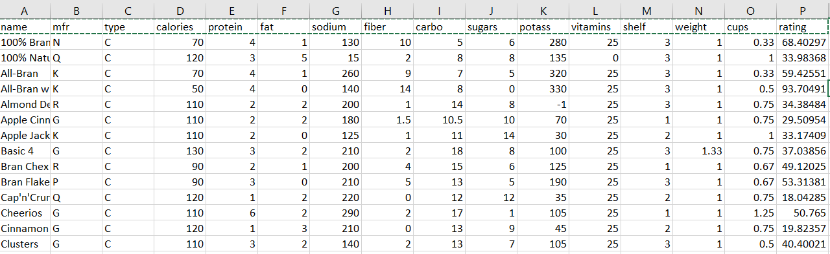
DATA
Cereals Dataset for determining the food with a high beneficiary diet.
78 rows with 16 columns
Name,
mfr,
type,
calories,
protein,
fat,
sodium ,
fiber ,
Carbo,
sugars,
potass,
vitamins,
shelf,
weight,
cups,
rating

Slide 6
DATA VISUALISATION:
Data visualization is where a given dataset is presented in a graphical format. It helps the detection of patterns, trends and correlations that might go undetected in text-based data. Understanding your data and the relationship present within it is just as important as any algorithm used to train your machine learning model. Machine learning models will perform poorly on data that wasn’t visualized and understood properly.
To visualize the dataset we need libraries called Matplotlib and Seaborn. The Matplotlib library is a Python 2D plotting library that allows you to generate plots, scatter plots, histograms, bar charts etc.

Slide 7
MODEL BUILDING
There are several Machine learning algorithms to be used depending on the data you are going to process such as images, sound, text, and numerical values. The algorithms that you can choose according to the objective that you might have it may be Classification algorithms or Regression algorithms.
Example:
1.Linear Regression
2.Logistic Regression
3. Random Forest Regression / Classification.
4. Decision Tree Regression / Classification.
You will need to train the datasets to run smoothly and see an incremental improvement in the prediction rate.
On our Dataset , we have applied Linear Regression to predict the Accuracy.

Slide 8
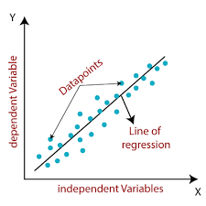
MACHINE LEARNING ALGORITMS
Linear Regression:
Linear Regression is a supervised machine learning algorithm where the predicted output is continuous and has a constant slope. It's used to predict values within a continuous range, (e.g. sales, price) rather than trying to classify them into categories (e.g. cat, dog).
Steps to implement Linear regression model:
Initialize the parameters.
Predict the value of a dependent variable by given an independent variable.
Calculate the error in prediction for all data points.
Calculate partial derivative w.r.t a0 and a1.
Calculate the cost for each number and add them.

Slide 9
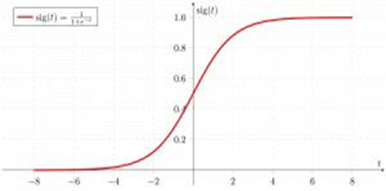
Multiple Linear Regression
Multiple Linear Regression is one of the important regression algorithms which models the linear relationship between a single dependent continuous variable and more than one independent variable.
Random Forest
A random forest is a machine learning technique that’s used to solve regression and classification problems. It utilizes ensemble learning, which is a technique that combines many classifiers to provide solutions to complex problems.
Working of Random Forest Algorithm
Step 1 − First, start with the selection of random samples from a given dataset.
Step 2 − Next, this algorithm will construct a decision tree for every sample. Then it will get the prediction result...
Step 3 − In this step, voting will be performed for every predicted result.
Step 4 − At last, select the most voted prediction result as the final prediction result.

Slide 10
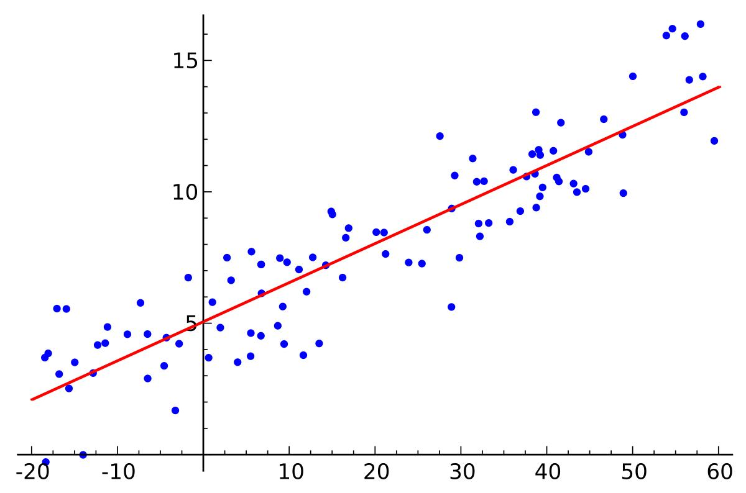
LOGISTIC REGRESSION:
Logistic regression is a supervised learning classification algorithm used to predict the probability of a target variable. The nature of target or dependent variable is dichotomous, which means there would be only two possible classes. ... Mathematically, a logistic regression model predicts P(Y=1) as a function of X.
Logistic Regression is used when the dependent variable (target) is categorical. For example,
To predict whether an email is a spam (1) or (0)
Whether the tumor is malignant (1) or not (0)

Slide 11
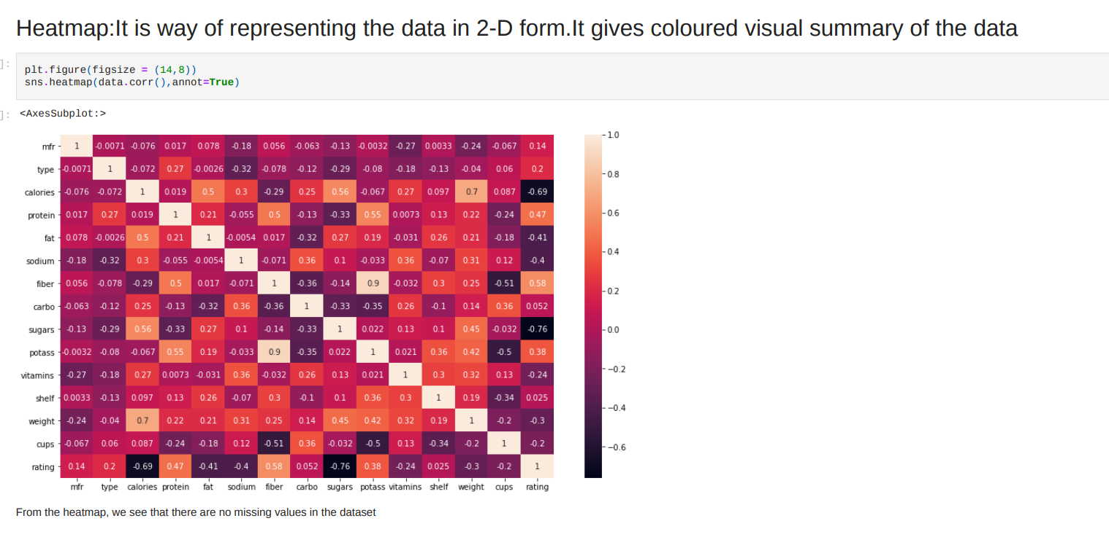
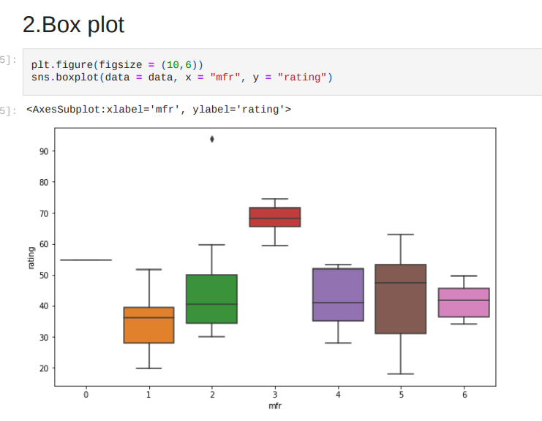
VISUALISATION OF GRAPHS

Slide 12
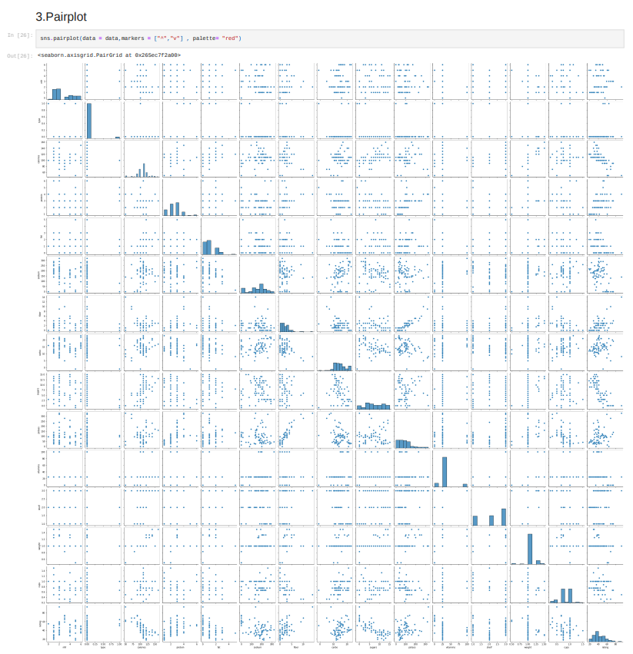
Pair plot usually gives pair wise relationships of the columns in the dataset From the above pair plot we infer Name,
mfr,
type,
calories,
protein,
fat,
sodium ,
fiber ,
Carbo,
sugars,
potass,
vitamins,
shelf,
weight,
cups,
rating

Slide 13
IBM WATSON STUDIO
IBM Acquired soft layer, a public cloud platform, to serve as the foundation for its IaaS offering. In October 2016, IBM rolled the soft layer brand under its Blue mix brand of PaaS offerings, giving users to access both IaaS and PaaS resources from a single console. IBM cloud provides a full-stack, public cloud platform with various products in the catalog, including options for compute, storage, networking, end to end developer solutions for app development, testing and deployment, security databases, and cloud native services.
We Created the IBM cloud account by going to the IBM cloud login page. Then we login to IBM Watson Studio and deployed our model on IBM.
Advantages of deploying model on CLOUD:
Security and privacy. Much like a private cloud, you can ensure your data remains secure when you are the only organization that uses the private portion of your infrastructure.
Potential cost savings.
Superior flexibility and scalability.

Slide 14
SOFTWARE REQUIREMENTS
Anaconda navigator
Jupyter notebook
Machine learning tools: pandas,
numpy,
matplotlib,
scikitlearn,
seaborn
IBM Watson Studio

Slide 15
CONCLUSION
In this project we have presented the high dietary food that is predicted on the basis of rating of the food.
Prediction is done using Machine Learning Techniques.
For the better results we used Linear regression algorithm and proved with 99% accuracy.

